Slide 1

LECTURE 5_2:
Requirements – more formal definitions
Instructor: Maria Striki
Presentation: Ivan Marsic, Maria Striki
Rutgers University

Slide 2
Topics
Actors, Goals
Sketchy/Summary Use Cases
Use Case Diagram
Traceability Matrix
System Boundary and Subsystems
Detailed Use Case Specification
System Sequence Diagrams
Security and Risk Management

Slide 3
Requirements engineering
The process of establishing the services that a customer requires from a system and the constraints under which it operates and is developed.
The system requirements are the descriptions of the system services and constraints that are generated during the requirements engineering process.

Slide 4
Types of requirement
User requirements
  Statements in natural language plus diagrams of the services the system provides and its operational constraints. Written for customers.
System requirements
  A structured document setting out detailed descriptions of the system’s functions, services and operational constraints. Defines what should be implemented so may be part of a contract between client and contractor.

Slide 5
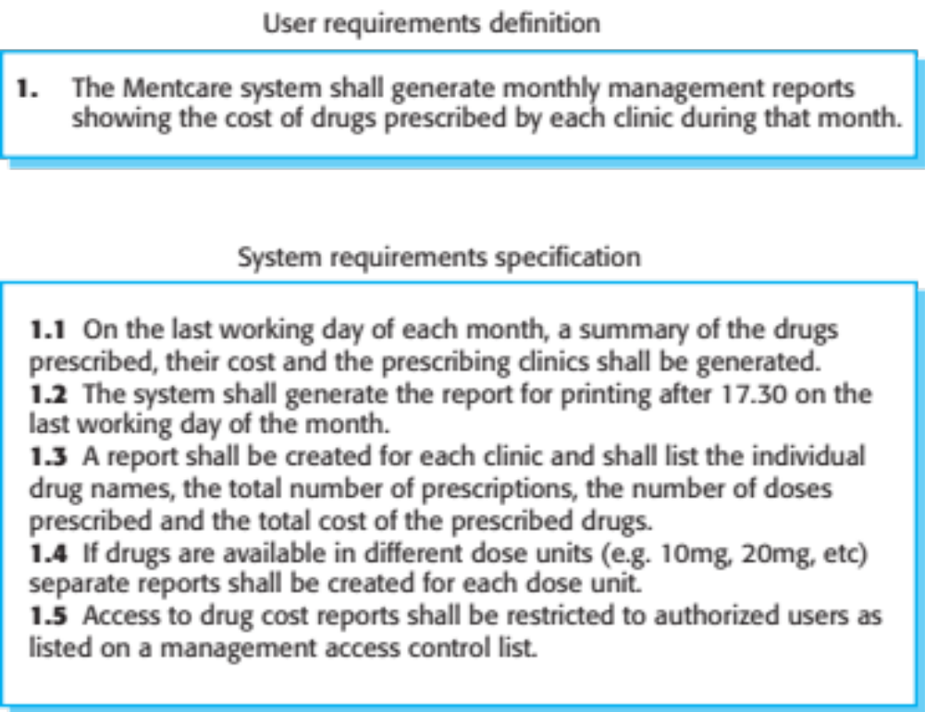
User and system requirements

Slide 6
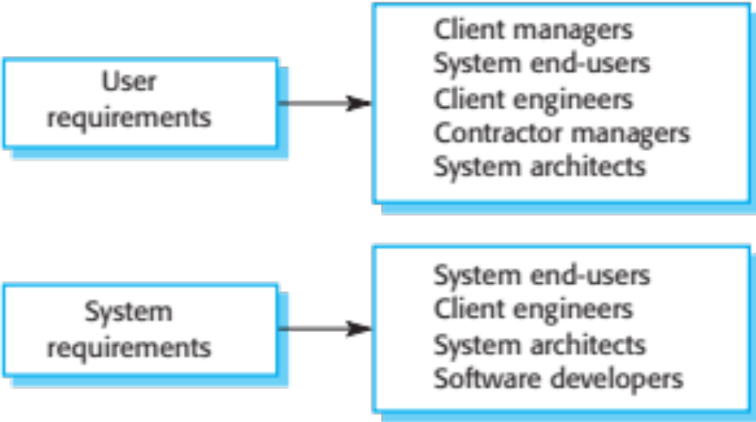
Readers of different types of requirements specification

Slide 7
System stakeholders
Any person or organization who is affected by the system in some way and so who has a legitimate interest
Stakeholder types
  End users
  System managers
  System owners
  External stakeholders

Slide 8
Agile methods and requirements
Many agile methods argue that producing detailed system requirements is a waste of time as requirements change so quickly.
The requirements document is therefore always out of date.
Agile methods usually use incremental requirements engineering and may express requirements as ‘user stories’ (discussed in Chapter 3).
This is practical for business systems but problematic for systems that require pre-delivery analysis (e.g. critical systems) or systems developed by several teams.

Slide 9
Functional and non-functional requirements
Functional requirements
  Statements of services the system should provide, how the system should react to particular inputs and how the system should behave in particular situations.
  May state what the system should not do.
Non-functional requirements
  Constraints on the services or functions offered by the system such as timing constraints, constraints on the development process, standards, etc.
  Often apply to the system as a whole rather than individual features or services.
Domain requirements
  Constraints on the system from the domain of operation

Slide 10
Functional requirements
Describe functionality or system services.
Depend on the type of software, expected users and the type of system where the software is used.
Functional user requirements may be high-level statements of what the system should do.
Functional system requirements should describe the system services in detail.

Slide 11
Mentcare system: functional requirements
A user shall be able to search the appointments lists for all clinics.
The system shall generate each day, for each clinic, a list of patients who are expected to attend appointments that day.
Each staff member using the system shall be uniquely identified by his or her 8-digit employee number.

Slide 12
Requirements imprecision
Problems arise when functional requirements are not precisely stated.
Ambiguous requirements may be interpreted in different ways by developers and users.
Consider the term ‘search’ in requirement 1
  User intention – search for a patient name across all appointments in all clinics;
  Developer interpretation – search for a patient name in an individual clinic. User chooses clinic then search.

Slide 13
Requirements completeness and consistency
In principle, requirements should be both complete and consistent.
Complete
  They should include descriptions of all facilities required.
Consistent
  There should be no conflicts or contradictions in the descriptions of the system facilities.
In practice, because of system and environmental complexity, it is impossible to produce a complete and consistent requirements document.

Slide 14
Non-functional requirements
These define system properties and constraints e.g. reliability, response time and storage requirements. Constraints are I/O device capability, system representations, etc.
Process requirements may also be specified mandating a particular IDE, programming language or development method.
Non-functional requirements may be more critical than functional requirements. If these are not met, the system may be useless.

Slide 15
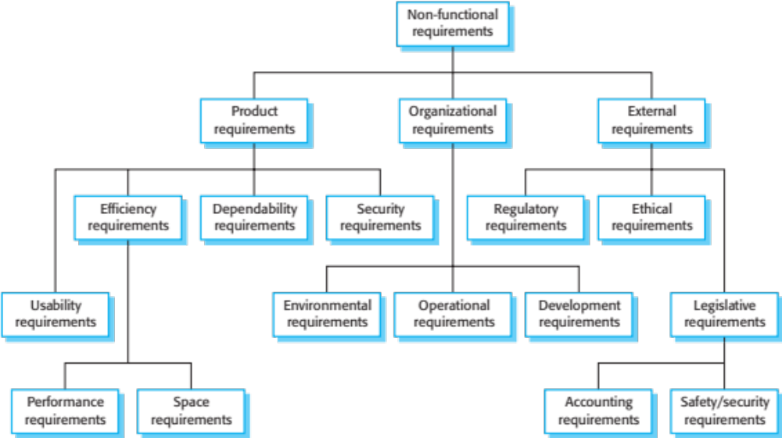
Types of nonfunctional requirement

Slide 16
Non-functional requirements implementation
Non-functional requirements may affect the overall architecture of a system rather than the individual components.
  For example, to ensure that performance requirements are met, you may have to organize the system to minimize communications between components.
A single non-functional requirement, such as a security requirement, may generate a number of related functional requirements that define system services that are required.
  It may also generate requirements that restrict existing requirements.

Slide 17
Non-functional classifications
Product requirements
  Requirements which specify that the delivered product must behave in a particular way e.g. execution speed, reliability, etc.
Organisational requirements
  Requirements which are a consequence of organisational policies and procedures e.g. process standards used, implementation requirements, etc.
External requirements
  Requirements which arise from factors which are external to the system and its development process e.g. interoperability requirements, legislative requirements, etc.

Slide 18
Examples of nonfunctional requirements in the Mentcare system
Product requirement The Mentcare system shall be available to all clinics during normal working hours (Mon–Fri, 0830–17.30). Downtime within normal working hours shall not exceed five seconds in any one day. Organizational requirement Users of the Mentcare system shall authenticate themselves using their health authority identity card. External requirement The system shall implement patient privacy provisions as set out in HStan-03-2006-priv.

Slide 19
Metrics for specifying nonfunctional requirements
Property | Measure
Speed | Processed transactions/second User/event response time Screen refresh time
Size | Mbytes Number of ROM chips
Ease of use | Training time Number of help frames
Reliability | Mean time to failure Probability of unavailability Rate of failure occurrence Availability
Robustness | Time to restart after failure Percentage of events causing failure Probability of data corruption on failure
Portability | Percentage of target dependent statements Number of target systems
Chapter 4 Requirements Engineering

Slide 20
Requirements engineering processes
The processes used for RE vary widely depending on the application domain, the people involved and the organisation developing the requirements.
However, there are a number of generic activities common to all processes
  Requirements elicitation;
  Requirements analysis;
  Requirements validation;
  Requirements management.
In practice, RE is an iterative activity in which these processes are interleaved.

Slide 21
Requirements elicitation
Software engineers work with a range of system stakeholders to find out about the application domain, the services that the system should provide, the required system performance, hardware constraints, other systems, etc.
Stages include:
  Requirements discovery,
  Requirements classification and organization,
  Requirements prioritization and negotiation,
  Requirements specification.

Slide 22
Problems of requirements elicitation
Stakeholders don’t know what they really want.
Stakeholders express requirements in their own terms.
Different stakeholders may have conflicting requirements.
Organisational and political factors may influence the system requirements.
The requirements change during the analysis process. New stakeholders may emerge and the business environment may change.

Slide 23
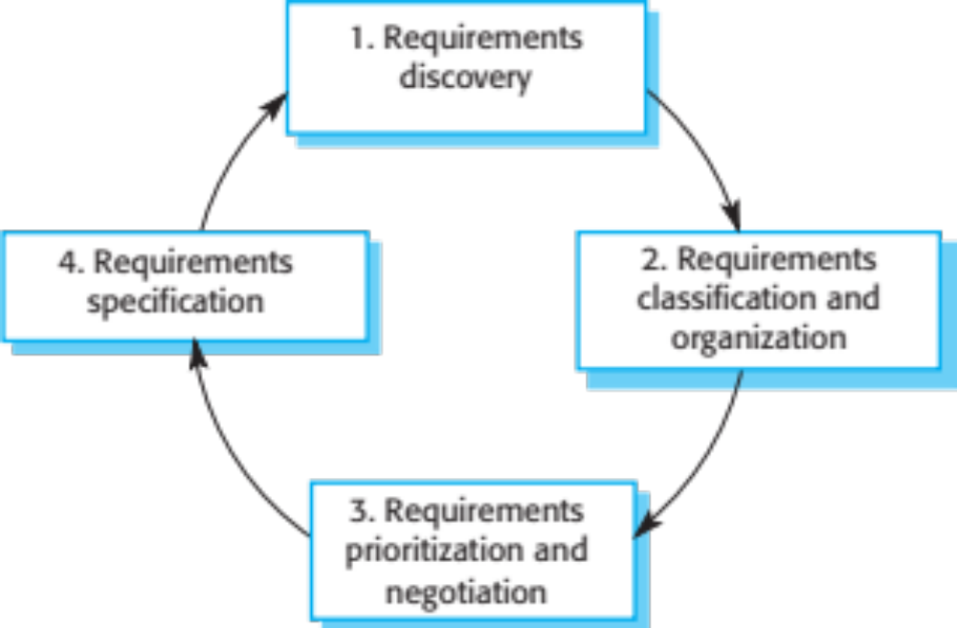
The requirements elicitation and analysis process

Slide 24
Stories and scenarios
Scenarios and user stories are real-life examples of how a system can be used.
Stories and scenarios are a description of how a system may be used for a particular task.
Because they are based on a practical situation, stakeholders can relate to them and can comment on their situation with respect to the story.

Slide 25
Scenarios
A structured form of user story
Scenarios should include
  A description of the starting situation;
  A description of the normal flow of events;
  A description of what can go wrong;
  Information about other concurrent activities;
  A description of the state when the scenario finishes.

Slide 26
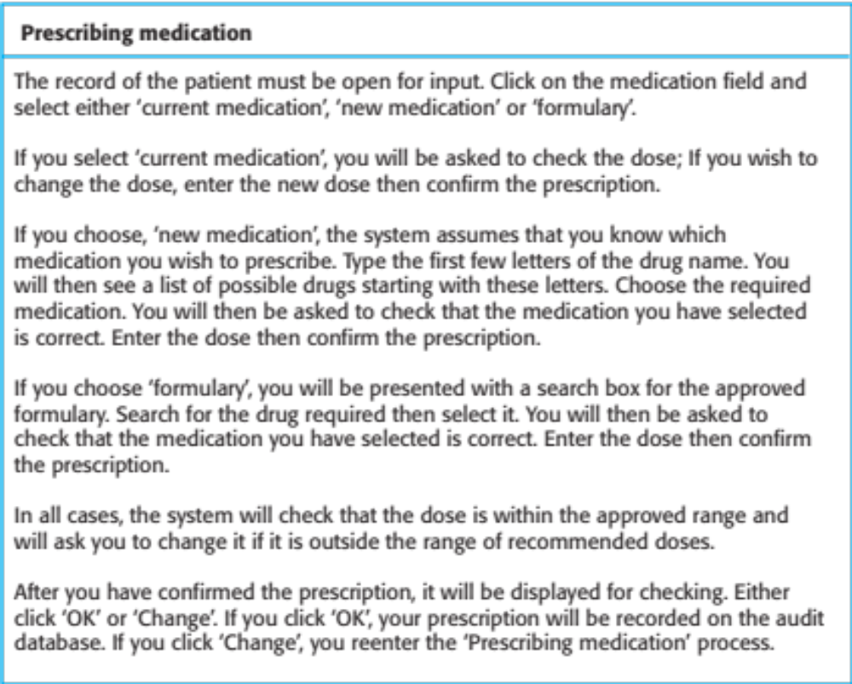
A ‘prescribing medication’ story

Slide 27
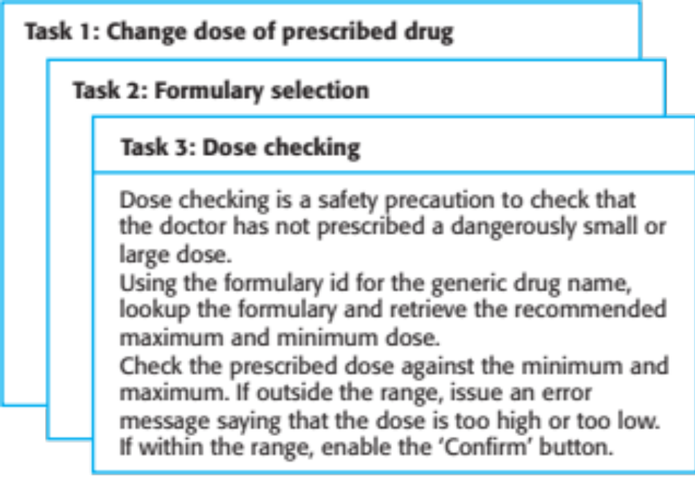
Examples of task cards for prescribing medication

Slide 28
Requirements and design
In principle, requirements should state what the system should do and the design should describe how it does this.
In practice, requirements and design are inseparable
  A system architecture may be designed to structure the requirements;
  The system may inter-operate with other systems that generate design requirements;
  The use of a specific architecture to satisfy non-functional requirements may be a domain requirement.
  This may be the consequence of a regulatory requirement.

Slide 29
Natural language specification
Requirements are written as natural language sentences supplemented by diagrams and tables.
Used for writing requirements because it is expressive, intuitive and universal. This means that the requirements can be understood by users and customers.

Slide 30
Problems with natural language
Lack of clarity
  Precision is difficult without making the document difficult to read.
Requirements confusion
  Functional and non-functional requirements tend to be mixed-up.
Requirements amalgamation
  Several different requirements may be expressed together.

Slide 31
Example requirements for the insulin pump software system
3.2 The system shall measure the blood sugar and deliver insulin, if required, every 10 minutes. (Changes in blood sugar are relatively slow so more frequent measurement is unnecessary; less frequent measurement could lead to unnecessarily high sugar levels.) 3.6 The system shall run a self-test routine every minute with the conditions to be tested and the associated actions defined in Table 1. (A self-test routine can discover hardware and software problems and alert the user to the fact the normal operation may be impossible.)

Slide 32
Structured specifications
An approach to writing requirements where the freedom of the requirements writer is limited and requirements are written in a standard way.
This works well for some types of requirements e.g. requirements for embedded control system but is sometimes too rigid for writing business system requirements.

Slide 33
Form-based specifications
Definition of the function or entity.
Description of inputs and where they come from.
Description of outputs and where they go to.
Information about the information needed for the computation and other entities used.
Description of the action to be taken.
Pre and post conditions (if appropriate).
The side effects (if any) of the function.

Slide 34
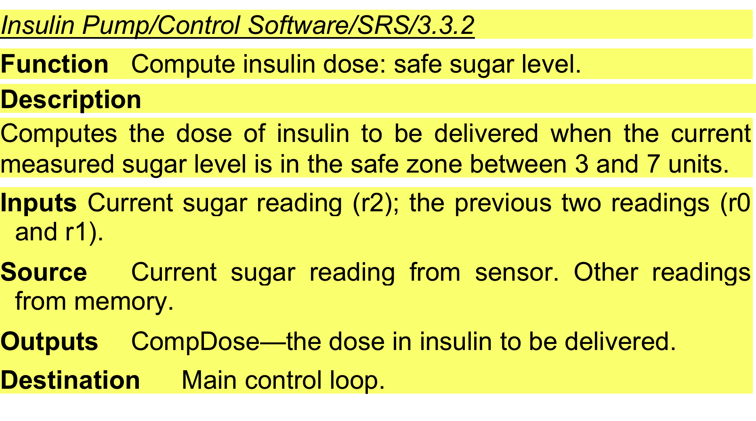
A structured specification of a requirement for an insulin pump

Slide 35
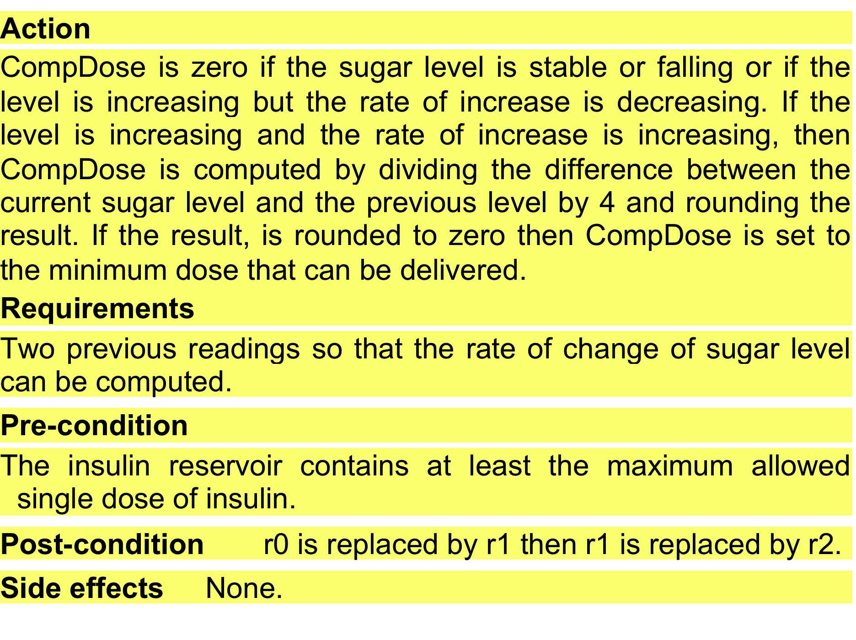
A structured specification of a requirement for an insulin pump

Slide 36
Use Cases

Slide 37
Use case modeling
Use cases were developed originally to support requirements elicitation and now incorporated into the UML.
Each use case represents a discrete task that involves external interaction with a system.
Actors in a use case may be people or other systems.
Represented diagramatically to provide an overview of the use case and in a more detailed textual form.
30/10/2014
Chapter 5 System Modeling

Slide 38
Use Cases
For Functional Requirements Analysis and Specification
A use case is a description of how a user will use the system-to-be to accomplish business goals
  Detailed use cases are usually written as usage scenarios or scripts, listing a specific sequence of actions and interactions between the actors and the system

Slide 39
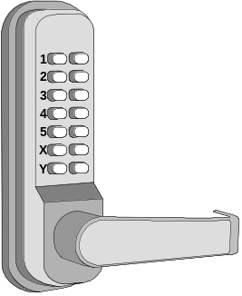
Deriving Use Cases from
System Requirements
REQ1: Keep door locked and auto-lock
REQ2: Lock when “LOCK” pressed
REQ3: Unlock when valid key provided
REQ4: Allow mistakes but prevent dictionary attacks
REQ5: Maintain a history log
REQ6: Adding/removing users at runtime
REQ7: Configuring the device activation preferences
REQ8: Inspecting the access history
REQ9: Filing inquiries
Actor | Actor’s Goal (what the actor intends to accomplish) | Use Case Name
Landlord | To disarm the lock and enter, and get space lighted up. | Unlock (UC-1)
Landlord | To lock the door & shut the lights (sometimes?). | Lock (UC-2)
Landlord | To create a new user account and allow access to home. | AddUser (UC-3)
Landlord | To retire an existing user account and disable access. | RemoveUser (UC-4)
Tenant | To find out who accessed the home in a given interval of time and potentially file complaints. | InspectAccessHistory (UC-5)
Tenant | To disarm the lock and enter, and get space lighted up. | Unlock (UC-1)
Tenant | To lock the door & shut the lights (sometimes?). | Lock (UC-2)
Tenant | To configure the device activation preferences. | SetDevicePrefs (UC-6)
LockDevice | To control the physical lock mechanism. | UC-1, UC-2
LightSwitch | To control the lightbulb. | UC-1, UC-2
[to be identified] | To auto-lock the door if it is left unlocked for a given interval of time. | AutoLock (UC-2)
( Actors already given if working from user stories instead of system requirements )

Slide 40
Types of Actors
Initiating actor (also called primary actor or “user”): initiates the use case to realize a goal
Participating actor (also called secondary actor): participates in the use case but does not initiate it:
  Supporting actor: helps the system-to-be to complete the use case
  Offstage actor: passively participates in the use case, i.e., neither initiates nor helps complete the use case, but may be notified about some aspect of it (e.g., for keeping records)

Slide 41
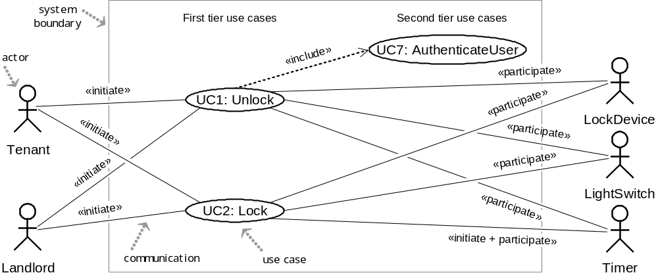
Use Case Diagram: Device Control
UC1: Unlock
UC2: Lock
UC3: AddUser
UC4: RemoveUser
UC5: InspectAccessHistory
UC6: SetDevicePrefs
UC7: AuthenticateUser
UC8: Login

Slide 42
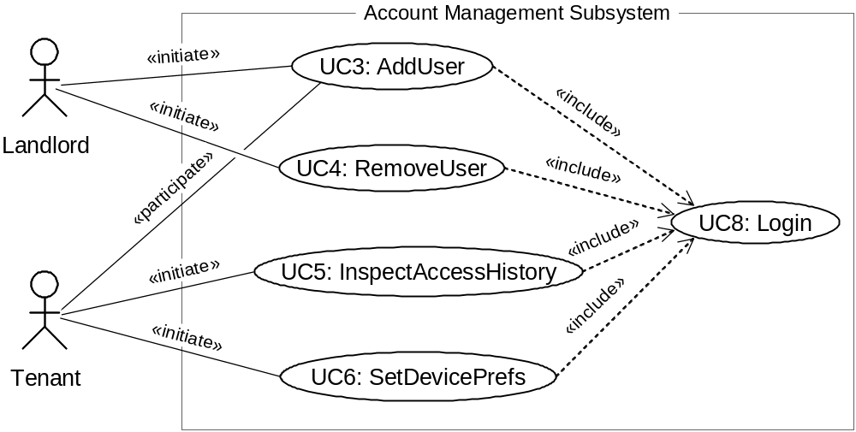
Use Case Diagram: Account Management
UC1: Unlock
UC2: Lock
UC3: AddUser
UC4: RemoveUser
UC5: InspectAccessHistory
UC6: SetDevicePrefs
UC7: AuthenticateUser
UC8: Login

Slide 43
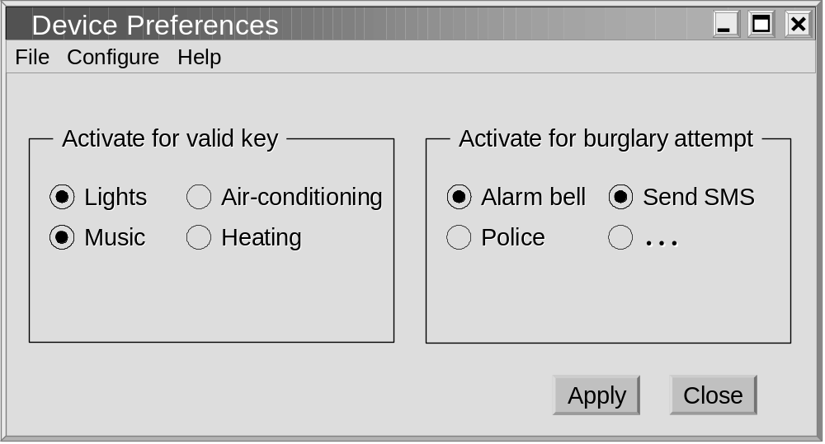
GUI for UC6: Set Device Pref’s
( NOTE: Lock device is mandatory )

Slide 44
Use Case Generalizations
UC1: Unlock
UC2: Lock
UC3: AddUser
UC4: RemoveUser
UC5: InspectAccessHistory
UC6: SetDevicePrefs
UC7: AuthenticateUser
UC8: Login
Resident
ManageUsers
Tenant
Landlord
UC3: AddUser
UC4: RemoveUser
Actor Generalization
Use Case Generalization

Slide 45
Optional Use Cases: «extend»
UC1: Unlock
UC2: Lock
UC3: AddUser
UC4: RemoveUser
UC5: InspectAccessHistory
UC6: SetDevicePrefs
UC7: AuthenticateUser
UC8: Login
Example optional use cases:
UC5: InspectAccessHistory
«extend»
ManageAccount
«extend»
UC6: SetDevicePrefs
Key differences between «include» and «extend» relationships
Included use case
Extending use case
Is this use case optional?
No
Yes
Is the base use case complete without this use case?
No
Yes
Is the execution of this use case conditional?
No
Yes
Does this use case change the behavior of the base use case?
No
Yes
[ Source: Robert Maksimchuk & Eric Naiburg: UML for Mere Mortals, Addison-Wesley, 2005. ]

Slide 46
Login Use Case?
BAD:
GOOD:
Login
AddUser
AddUser
«include»
Login
Landlord
SetDevicePrefs
Landlord
SetDevicePrefs
«include»

Slide 47
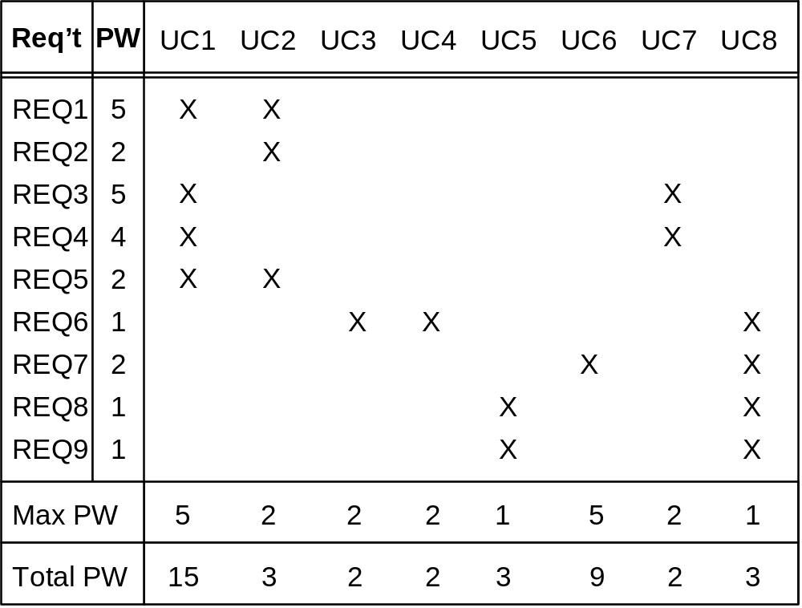
Traceability Matrix (1)
Mapping: System requirements to Use cases
UC1: Unlock
UC2: Lock
UC3: AddUser
UC4: RemoveUser
UC5: InspectAccessHistory
UC6: SetDevicePrefs
UC7: AuthenticateUser
UC8: Login
REQ1: Keep door locked and auto-lock
REQ2: Lock when “LOCK” pressed
REQ3: Unlock when valid key provided
REQ4: Allow mistakes but prevent dictionary attacks
REQ5: Maintain a history log
REQ6: Adding/removing users at runtime
REQ7: Configuring the device activation preferences
REQ8: Inspecting the access history
REQ9: Filing inquiries
Continued for domain model, design diagrams, …

Slide 48
Traceability Matrix Purpose
To check that all requirements are covered by the use cases
To check that none of the use cases is introduced without a reason (i.e., created not in response to any requirement)
To prioritize the work on use cases

Slide 49
Schema for Detailed Use Cases
Use Case UC-#: |  |  |  | Name / Identifier [verb phrase]
Related Requirements: |  |  |  | List of the requirements that are addressed by this use case
Initiating Actor: |  |  |  | Actor who initiates interaction with the system to accomplish a goal
Actor’s Goal: |  |  |  | Informal description of the initiating actor’s goal
Participating Actors: |  |  |  | Actors that will help achieve the goal or need to know about the outcome
Preconditions: |  |  |  | What is assumed about the state of the system before the interaction starts
Postconditions: |  |  |  | What are the results after the goal is achieved or abandoned; i.e., what must be true about the system at the time the execution of this use case is completed
Flow of Events for Main Success Scenario:
→ | 1. | The initiating actor delivers an action or stimulus to the system (the arrow indicates the direction of interaction, to- or from the system)
← | 2. | The system’s reaction or response to the stimulus; the system can also send a message to a participating actor, if any
→ | 3. | …
Flow of Events for Extensions (Alternate Scenarios): What could go wrong? List the exceptions to the routine and describe how they are handled
→ | 1a. | For example, actor enters invalid data
← | 2a. | For example, power outage, network failure, or requested data unavailable
 |  | …
The arrows on the left indicate the direction of interaction: → Actor’s action; ← System’s reaction

Slide 50
Use Case 1: Unlock
Use Case UC-1: |  |  | Unlock
Related Requirem’ts: |  |  | REQ1, REQ3, REQ4, and REQ5 stated in Table 2-1
Initiating Actor: |  |  | Any of: Tenant, Landlord
Actor’s Goal: |  |  | To disarm the lock and enter, and get space lighted up automatically.
Participating Actors: |  |  | LockDevice, LightSwitch, Timer
Preconditions: |  |  | • The set of valid keys stored in the system database is non-empty. • The system displays the menu of available functions; at the door keypad the menu choices are “Lock” and “Unlock.”
Postconditions: |  |  | The auto-lock timer has started countdown from autoLockInterval.
Flow of Events for Main Success Scenario:
→ | 1. | Tenant/Landlord arrives at the door and selects the menu item “Unlock”
 | 2. | include::AuthenticateUser (UC-7)
← | 3. | System (a) signals to the Tenant/Landlord the lock status, e.g., “disarmed,” (b) signals to LockDevice to disarm the lock, and (c) signals to LightSwitch to turn the light on
← | 4. | System signals to the Timer to start the auto-lock timer countdown
→ | 5. | Tenant/Landlord opens the door, enters the home [and shuts the door and locks]

Slide 51
Subroutine «include» Use Case
Use Case UC-7: |  |  |  | AuthenticateUser (sub-use case)
Related Requirements: |  |  |  | REQ3, REQ4 stated in Table 2‑1
Initiating Actor: |  |  |  | Any of: Tenant, Landlord
Actor’s Goal: |  |  |  | To be positively identified by the system (at the door interface).
Participating Actors: |  |  |  | AlarmBell, Police
Preconditions: |  |  |  | • The set of valid keys stored in the system database is non-empty. • The counter of authentication attempts equals zero.
Postconditions: |  |  |  | None worth mentioning.
Flow of Events for Main Success Scenario:
← | 1. | System prompts the actor for identification, e.g., alphanumeric key
→ | 2. | Tenant/Landlord supplies a valid identification key
← | 3. | System (a) verifies that the key is valid, and (b) signals to the actor the key validity
Flow of Events for Extensions (Alternate Scenarios):
2a. Tenant/Landlord enters an invalid identification key
← | 1. | System (a) detects error, (b) marks a failed attempt, and (c) signals to the actor
← |  | 1a. | System (a) detects that the count of failed attempts exceeds the maximum allowed number, (b) signals to sound AlarmBell, and (c) notifies the Police actor of a possible break-in
→ | 2. | Tenant/Landlord supplies a valid identification key
 | 3. | Same as in Step 3 above

Slide 52
Acceptance Test Case for
UC-7 Authenticate User
Test-case Identifier: | TC-1
Use Case Tested: | UC-1, main success scenario, and UC-7
Pass/fail Criteria: | The test passes if the user enters a key that is contained in the database, with less than a maximum allowed number of unsuccessful attempts
Input Data: | Numeric keycode, door identifier
Test Procedure: |  | Expected Result:
Step 1. Type in an incorrect keycode and a valid door identifier |  | System beeps to indicate failure; records unsuccessful attempt in the database; prompts the user to try again
Step 2. Type in the correct keycode and door identifier |  | System flashes a green light to indicate success; records successful access in the database; disarms the lock device

Slide 53
Use Case 2: Lock
Use Case UC-2: |  |  | Lock
Related Requirements: |  |  | REQ1, REQ2, and REQ5 stated in Table 2-1
Initiating Actor: |  |  | Any of: Tenant, Landlord, or Timer
Actor’s Goal: |  |  | To lock the door & get the lights shut automatically (?)
Participating Actors: |  |  | LockDevice, LightSwitch, Timer
Preconditions: |  |  | The system always displays the menu of available functions.
Postconditions: |  |  | The door is closed and lock armed & the auto-lock timer is reset.
Flow of Events for Main Success Scenario:
→ | 1. | Tenant/Landlord selects the menu item “Lock”
← | 2. | System (a) signals affirmation, e.g., “lock armed,” (b) signals to LockDevice to arm the lock (if not already armed), (c) signal to Timer to reset the auto-lock counter, and (d) signals to LightSwitch to turn the light off (?)
Flow of Events for Extensions (Alternate Scenarios):
2a. System senses that the door is not closed, so the lock cannot be armed
← | 1. | System (a) signals a warning that the door is open, and (b) signal to Timer to start the alarm counter
→ | 2. | Tenant/Landlord closes the door
← | 3. | System (a) senses the closure, (b) signals affirmation to the Tenant/Landlord, (c) signals to LockDevice to arm the lock, (d) signal to Timer to reset the auto-lock counter, and (e) signal to Timer to reset the alarm counter

Slide 54
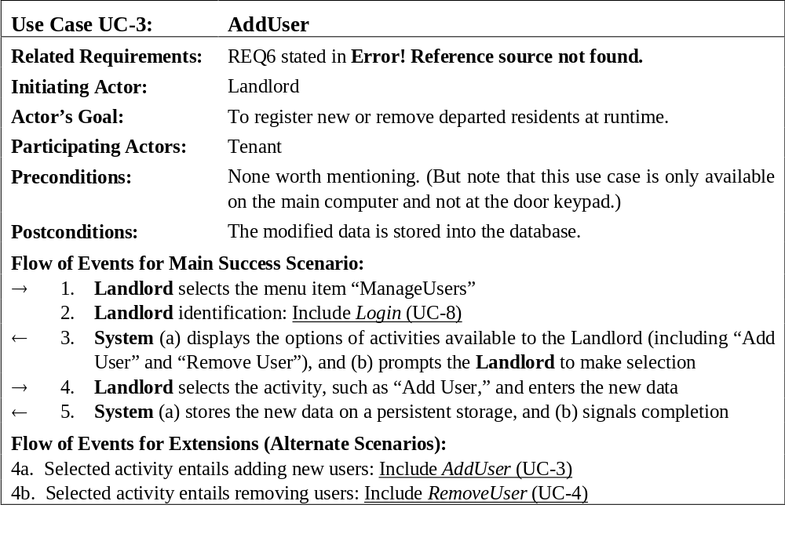
Use Case 3: Add User

Slide 55
Use Case 5: Inspect Access History
Use Case UC-5: |  |  | Inspect Access History
Related Requirements: |  |  | REQ8 and REQ9 stated in Table 2-1
Initiating Actor: |  |  | Any of: Tenant, Landlord
Actor’s Goal: |  |  | To examine the access history for a particular door.
Participating Actors: |  |  | Database, Landlord
Preconditions: |  |  | Tenant/Landlord is logged in the system and is shown a hyperlink “View Access History.”
Postconditions: |  |  | None.
Flow of Events for Main Success Scenario:
→ | 1. | Tenant/Landlord clicks the hyperlink “View Access History”
← | 2. | System prompts for the search criteria (e.g., time frame, door location, actor role, event type, etc.) or “Show all”
→ | 3. | Tenant/Landlord specifies the search criteria and submits
← | 4. | System prepares a database query that best matches the actor’s search criteria and retrieves the records from the Database
→ | 5. | Database returns the matching records
← | 6. | System (a) additionally filters the retrieved records to match the actor’s search criteria; (b) renders the remaining records for display; and (c) shows the result for Tenant/Landlord’s consideration
→ | 7. | Tenant/Landlord browses, selects “interesting” records (if any), and requests further investigation (with an accompanying complaint description)
← | 8. | System (a) displays only the selected records and confirms the request; (b) archives the request in the Database and assigns it a tracking number; (c) notifies Landlord about the request; and (d) informs Tenant/Landlord about the tracking number

Slide 56
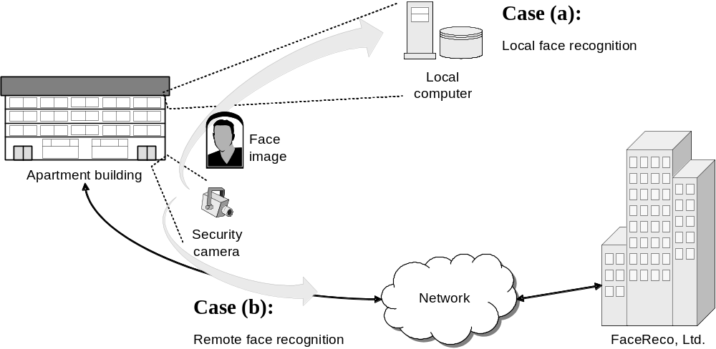
System Boundary & Subsystems
Use Case Variations Example:

Slide 57
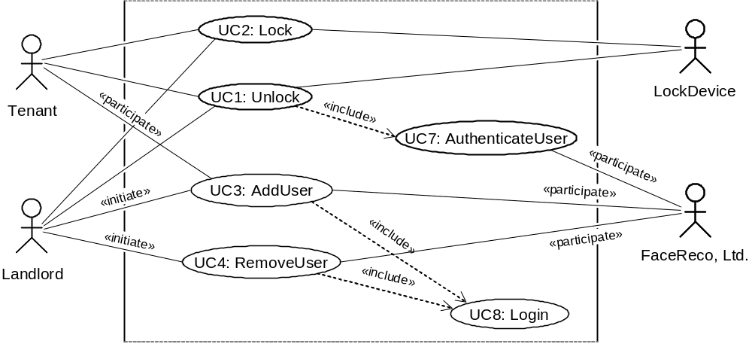
Modified Use Case Diagram
UC1: Unlock
UC2: Lock
UC3: AddUser
UC4: RemoveUser
UC5: InspectAccessHistory
UC6: SetDevicePrefs
UC7: AuthenticateUser
UC8: Login
Authentication subsystem (FaceReco, Ltd.)
is externalized from the system-to-be:

Slide 58
Security and Risk Management
Identifying and preempting the serious risks to system’s safe and successful functioning
Risk types:
  Intolerable
  As low as reasonably practical (ALARP)
  Acceptable
Example abuse case input sequence:
    invalid-key, invalid-key, … ≤ maxNumOfAttempts ;
    wait maxAttemptPeriod ; invalid-key, invalid-key, …

Slide 59
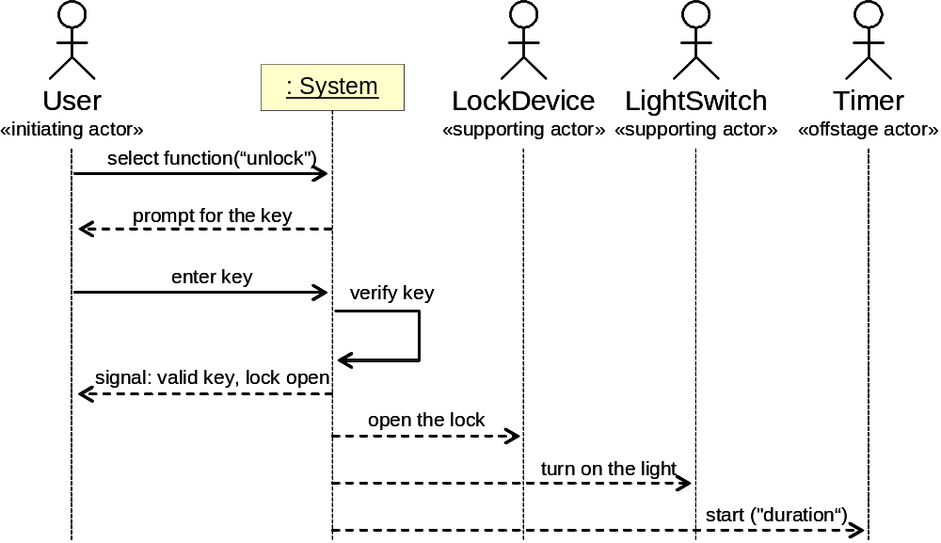
System Sequence Diagram
[Modeling System Workflows]
Use case: Unlock
Main success scenario
Similar to UML sequence diagrams,
but for actor interactions instead of software object interactions

Slide 60
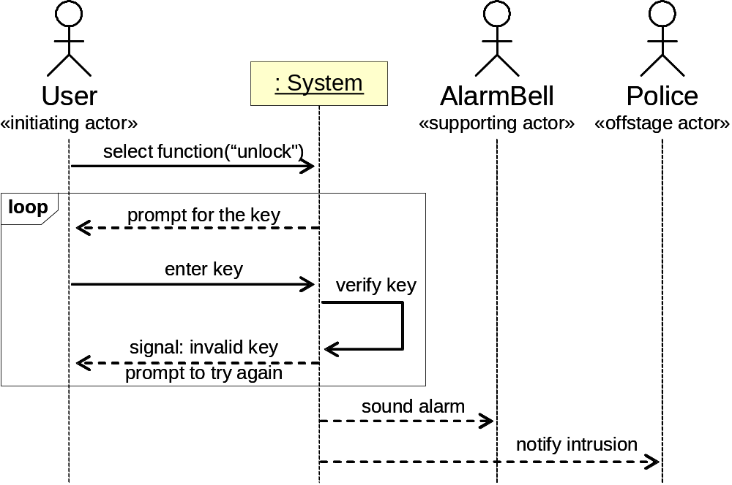
System Sequence Diagram
[Modeling System Workflows]
Use case: Unlock
Alternate scenario (burglary attempt)

Slide 61
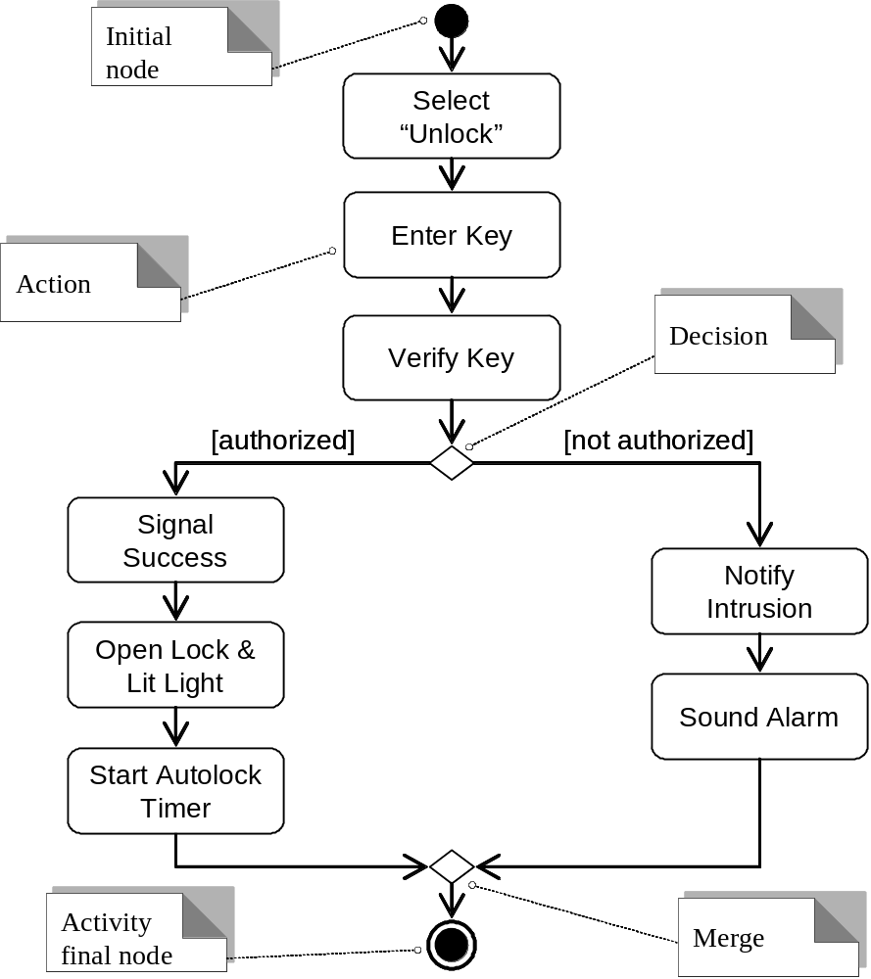
Activity Diagram
[Modeling System Workflows]

Slide 62
Requirements validation
Concerned with demonstrating that the requirements define the system that the customer really wants.
Requirements error costs are high so validation is very important
  Fixing a requirements error after delivery may cost up to 100 times the cost of fixing an implementation error.

Slide 63
Requirements checking
Validity. Does the system provide the functions which best support the customer’s needs?
Consistency. Are there any requirements conflicts?
Completeness. Are all functions required by the customer included?
Realism. Can the requirements be implemented given available budget and technology
Verifiability. Can the requirements be checked?

Slide 64
Requirements validation techniques
Requirements reviews
  Systematic manual analysis of the requirements.
Prototyping
  Using an executable model of the system to check requirements. Test-case generation
  Developing tests for requirements to check testability.

Slide 65
Review checks
Verifiability
  Is the requirement realistically testable?
Comprehensibility
  Is the requirement properly understood?
Traceability
  Is the origin of the requirement clearly stated?
Adaptability
  Can the requirement be changed without a large impact on other requirements?

Slide 66
Requirements management planning
Establishes the level of requirements management detail that is required.
Requirements management decisions:
  Requirements identification Each requirement must be uniquely identified so that it can be cross-referenced with other requirements.
  A change management process This is the set of activities that assess the impact and cost of changes. I discuss this process in more detail in the following section.
  Traceability policies These policies define the relationships between each requirement and between the requirements and the system design that should be recorded.
  Tool support Tools that may be used range from specialist requirements management systems to spreadsheets and simple database systems.

Slide 67
Requirements change management
Deciding if a requirements change should be accepted
  Problem analysis and change specification
    During this stage, the problem or the change proposal is analyzed to check that it is valid. This analysis is fed back to the change requestor who may respond with a more specific requirements change proposal, or decide to withdraw the request.
  Change analysis and costing
    The effect of the proposed change is assessed using traceability information and general knowledge of the system requirements. Once this analysis is completed, a decision is made whether or not to proceed with the requirements change.
  Change implementation
    The requirements document and, where necessary, the system design and implementation, are modified. Ideally, the document should be organized so that changes can be easily implemented.

Slide 68
Key points
Requirements for a software system set out what the system should do and define constraints on its operation and implementation.
Functional requirements are statements of the services that the system must provide or are descriptions of how some computations must be carried out.
Non-functional requirements often constrain the system being developed and the development process being used.
They often relate to the emergent properties of the system and therefore apply to the system as a whole.
30/10/2014
Chapter 4 Requirements Engineering

Slide 69
Key points
The requirements engineering process is an iterative process that includes requirements elicitation, specification and validation.
Requirements elicitation is an iterative process that can be represented as a spiral of activities – requirements discovery, requirements classification and organization, requirements negotiation and requirements documentation.
You can use a range of techniques for requirements elicitation including interviews and ethnography. User stories and scenarios may be used to facilitate discussions.
30/10/2014
Chapter 4 Requirements Engineering

Slide 70
Key points
Requirements specification is the process of formally documenting the user and system requirements and creating a software requirements document.
The software requirements document is an agreed statement of the system requirements. It should be organized so that both system customers and software developers can use it.
30/10/2014
Chapter 4 Requirements Engineering

Slide 71
Key points
Requirements validation is the process of checking the requirements for validity, consistency, completeness, realism and verifiability.
Business, organizational and technical changes inevitably lead to changes to the requirements for a software system. Requirements management is the process of managing and controlling these changes.

